Slide 1
Data analysis presentation
~by Jayesh Mandavkar

Slide 2
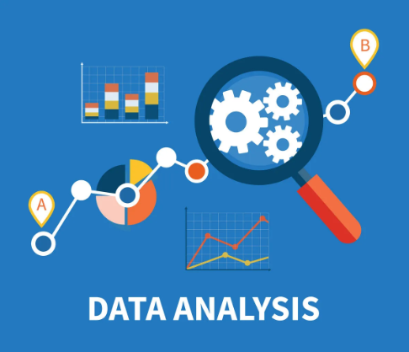
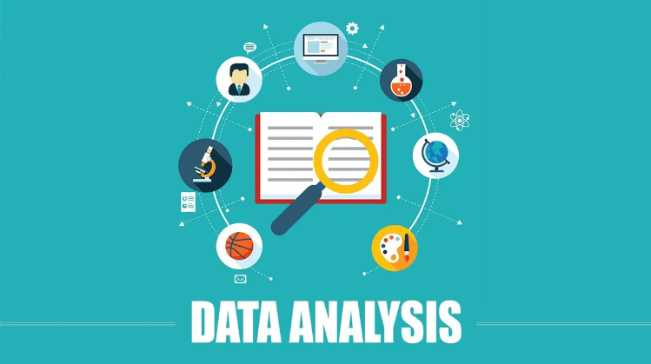
Data Analysis
The Definition
It is an art of exploring, cleaning transforming and analyzing the data, in order to extract the meaningful insights form it.
Data is an oil of 21st century and data analysis is the combustion engine.
~Clive Humby

Slide 3

Importance of Cleaned Data
The quality of data is crucial for accurate and reliable data analysis. Poor data quality can lead to flawed analysis and incorrect conclusions, which can have significant consequences for businesses or organizations. It is, therefore, essential to ensure that data is accurate, complete, consistent, and relevant before beginning the analysis process. This can involve data cleaning, data validation, and data verification techniques to identify and correct errors in the data.

Slide 4
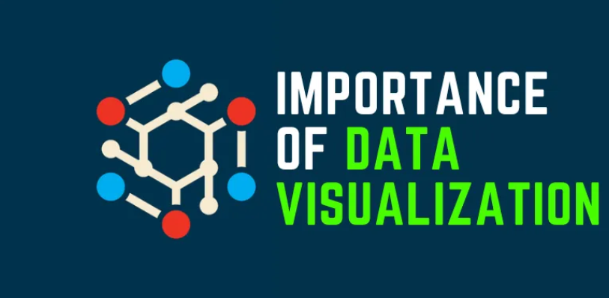
Importance of Data Visualization
Data visualization is an essential aspect of data analysis that involves the use of graphical and visual representations to present data in a meaningful way. Effective data visualization can help users to understand complex data sets quickly, identify trends and patterns, and make informed decisions based on the findings.
It can also enable organizations to communicate data insights to stakeholders more effectively and facilitate data-driven decision-making. It is, therefore, important to use appropriate data visualization techniques, such as charts, graphs, and dashboards, to enhance the clarity and impact of data analysis.

Slide 5
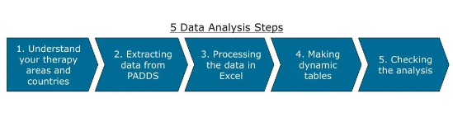
Steps in Data Analysis
Define the problem
Data collection
Data cleaning and data pre-processing
Exploratory data analysis
Data modelling
Data visualization
Report creation

Slide 6





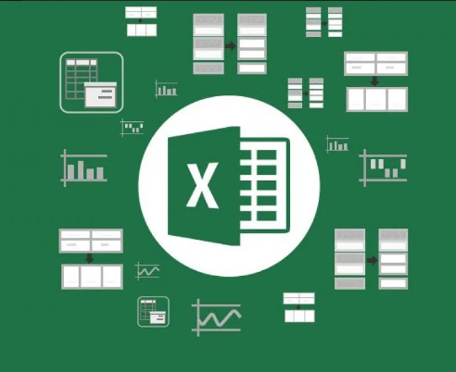
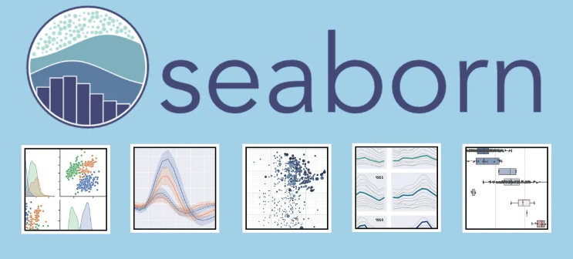



Tools and technologies used in Data Analysis
SQL
MS-Excel
Python
Statistics
BI Tools
Cloud Platforms

Slide 7





Applications of Data Analysis
Business Intelligence
Healthcare
Finance
Social Media
Environmental Science

Slide 8
Thank You

